Slide 1
HW6 Support Material

Slide 2
# Step 1: Load the data
# Packages/Librarys: ggplot2, reshape2
# data set airquality is R provided
# suggest storing in another data set ie “air”

Slide 3
# Step 2: Clean the data
# find which columns in the dataframe contain NAs.
# Check if the NAs in column "Ozone" and replace them by the mean value of this column
# Check if the NAs in column "Solar.R" and replace those NAs by the mean value of this column

Slide 4
# Step 3: Understand the data distribution
# histograms for each of the variables
# use the Ozone in "air" dataframe as X variable to create a histogram
# set the bin width to be 5, border color to be white, and bin color to be black
# use the Solar in "air" dataframe as X variable to create a histogram
# use the Wind in "air" dataframe as X variable to create a histogram
# use the Temp in "air" dataframe as X variable to create a histogram
# use the Month in "air" dataframe as X variable to create a histogram
# use the Day in "air" dataframe as X variable to create a histogram
# create boxplot for Ozone
# create boxplot for Wind
# how will you handle grouping

Slide 5
Step 3: Explore how the data changes over time
# Paste the value in Month column, Day column, and "1973" together, and assign the result to the new created column called "Date"
# check the structure to see if the conversion works (sample on next slide)
# create line charts for ozone, temp, wind and solar.R seperately
# use dataframe "air" to create a line chart, considering "Date" as x variable, "Ozone" as y variable
# use "Temp" as y variable
# use "Wind" as y variable
# use "Solar.R" as y variable
# create one chart with 4 lines, each having a different color
# Rescale Wind values so that they won't be too close to the x axis, and store in a new column
# create a new dataframe containing the four y variables and the x variable (Date).
# reframe the dataframe to stack all the y variables into a single column before visualization (sample on next slide)
# create one chart with four lines, using "Date" as x variable, and the four factors as y variables
# the colors are differentiated by the four variables

Slide 6
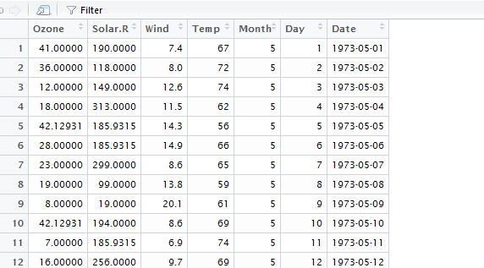
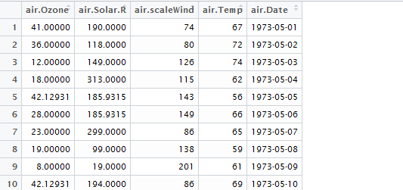
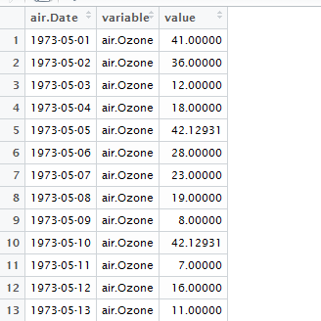

Slide 7
# Step 4: Look at all the data via a Heatmap
# suggest using data frame from step 3 to create the chart, with each day along the x-axis and ozone, temp, wind and solar.r along the y-axis (which data frame ??)
# Use geom_tile() function to demonstrate the chart as a heatmap, and fill the color according to variables' value

Slide 8
# Step 5: Look at all the data via a scatter chart
# Use data frame from step 2 to create a scatter chart, with "Wind" along x-axis and "Temp" along y-axis.
# Additionally, set the points' size according to "Ozone" value and set the shade of color according to "Solar.R" value.
# Step 6: Final Analysis
# Do you see any patterns after exploring the data?
# What was the most useful visualization?

